Slide 1
Regresión Por Mínimos Cuadrados Parte I
Dr. Luis Sanchez

Slide 2
Motivation
In engineering, two types of applications are encountered:
Trend analysis: Predicting values of dependent variable, may include extrapolation beyond data points or interpolation between data points.
Hypothesis testing: Comparing existing mathematical model with measured data.
What is the best mathematical function f that represents the dataset?
What is the best criterion to assess the fitting of the function f to the data?

Slide 3
Motivation
Given a set of experimental data:
x | 1 | 2 | 3
y | 5.1 | 5.9 | 6.3
The relationship between x and y may not be clear.
Find a function f(x) that best fit the data
1 2 3

Slide 4
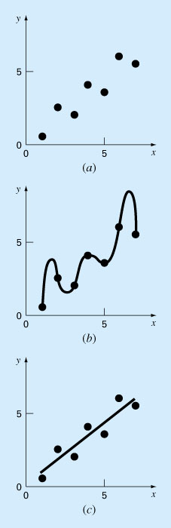
a) Datos que muestran un error significativo. b) Ajuste polinomial oscilando más allá del rango de los datos. c) Resultados más satisfactorios mediante el ajuste por mínimos cuadrados.

Slide 5
Mathematical Background
Arithmetic mean. The sum of the individual data points (yi) divided by the number of points (n).
Standard deviation. The most common measure of a spread for a sample.

Slide 6
Mathematical Background
Variance. Representation of spread by the square of the standard deviation.
or
Coefficient of variation. Has the utility to quantify the spread of data.

Slide 7
Least Squares Regression
Linear Regression
Fitting a straight line to a set of paired observations: (x₁, y₁), (x₂, y₂),…,(x_{n}, y_{n}).
y = a₀+ a₁ x + e
a₁ - slope
a₀ - intercept
e - error, or residual, between the model and the observations

Slide 8
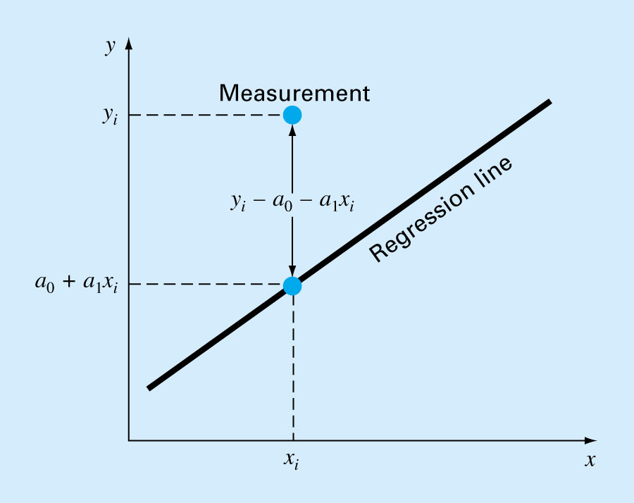
Linear Regression: Question
Linear Regression: Residual
How to find a₀ and a₁ so that the error would be minimum?

Slide 9
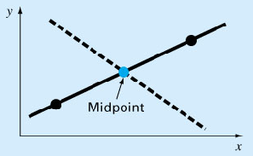
Linear Regression: Criteria for a “Best” Fit
e₁
e₁= -e₂
e₂

Slide 10
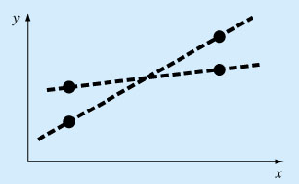
Linear Regression: Criteria for a “Best” Fit

Slide 11
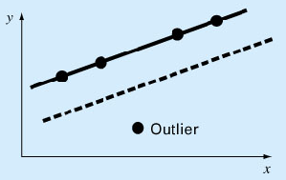
Linear Regression: Criteria for a “Best” Fit

Slide 12
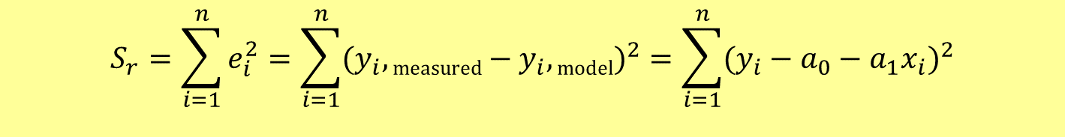
Linear Regression: Least Squares Fit
$$S_{r}=\sum_{i=1}^{n}{e_{i}^{2}}=\sum_{i=1}^{n}{(y_{i},\text{measured}−y_{i},\text{model})^{2}=\sum_{i=1}^{n}{(y_{i}−a_{0}−a_{1}x_{i})^{2}}}$$
Yields a unique line for a given set of data.

Slide 13
Linear Regression: Least Squares Fit
The coefficients a₀ and a₁ that minimize S_{r} must satisfy the following conditions:

Slide 14
Linear Regression: Determination of a_{o} and a₁
2 equations with 2 unknowns, can be solved simultaneously

Slide 15
Linear Regression: Determination of a_{o} and a₁

Slide 16
Error Quantification of Linear Regression
Total sum of the squares around the mean for the dependent variable, y, is S_{t}
Sum of the squares of residuals around the regression line is S_{r}

Slide 17
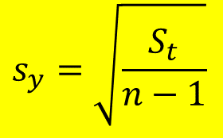
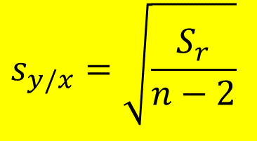
Least Squares Fit of a Straight Line: Error Analysis
The standard deviation (quantifies the spread around the mean):
$$s_{y}=\sqrt{\frac{S_{t}}{n−1}}$$
The standard error of estimate (quantifies the spread around the regression line)
$$s_{y/x}=\sqrt{\frac{S_{r}}{n−2}}$$

Slide 18
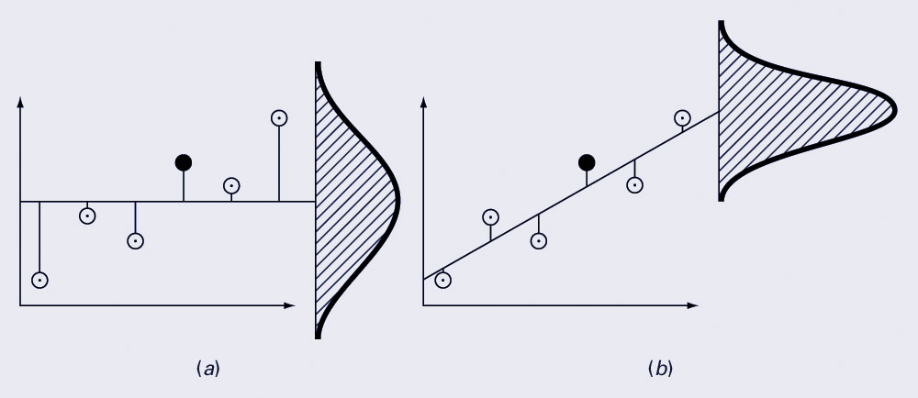
Linear regression versus the sample mean
What is the difference between linear regression and the case when we simply compute the sample mean and draw a line corresponding to the sample mean?
The spread → the histogram of the differences between the values predicted by linear regression and the actual sample values.
Regression data showing (a) the spread of data around the mean of the dependent data and (b) the spread of the data around the best fit line:
The reduction in spread represents the improvement due to linear regression.

Slide 19
Error Quantification of Linear Regression
S_{t}-S_{r} quantifies the improvement or error reduction due to describing data in terms of a straight line rather than as an average value.
r^{2:} coefficient of determination
r : correlation coefficient

Slide 20
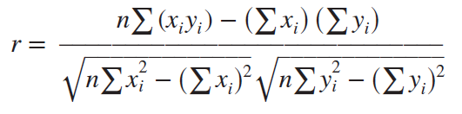
Error Quantification of Linear Regression
Comments:
For a perfect fit: S_{r}= 0 and r = r² =1, signifying that the line explains 100 percent of the variability of the data.
For r = r² = 0, S_{r} = S_{t}, the fit represents no improvement.
An alternative formulation for r that is more convenient for computer implementation is:

Slide 21
Least Squares Fit of a Straight Line: Example
Fit a straight line to the x and y values in the following Table:
x_{i} | y_{i} | x_{i}y_{i} | x_{i}²
1 | 0.5 | 0.5 | 1
2 | 2.5 | 5 | 4
3 | 2 | 6 | 9
4 | 4 | 16 | 16
5 | 3.5 | 17.5 | 25
6 | 6 | 36 | 36
7 | 5.5 | 38.5 | 49
28 | 24 | 119.5 | 140

Slide 22
Least Squares Fit of a Straight Line: Example (cont’d)
Y = 0.07142857 + 0.8392857 x

Slide 23
Least Squares Fit of a Straight Line: Example (Error Analysis)
x_{i} y_{i}
1 0.5
2 2.5
3 2.0
4 4.0
5 3.5
6 6.0
7 5.5
8.5765 0.1687 0.8622 0.5625
2.0408 0.3473 0.3265 0.3265
0.0051 0.5896 6.6122 0.7972
4.2908 0.1993
28 24.0 22.7143 2.9911

Slide 24
Least Squares Fit of a Straight Line: Example (Error Analysis)
The standard deviation (quantifies the spread around the mean):
The standard error of estimate (quantifies the spread around the regression line)
Because , the linear regression model has good fitness

Slide 25
Linearization of Nonlinear Relationships
The relationship between the dependent and independent variables is linear.
However, a few types of nonlinear functions can be transformed into linear regression problems.
The exponential equation.
The power equation.
The saturation-growth-rate equation.

Slide 26
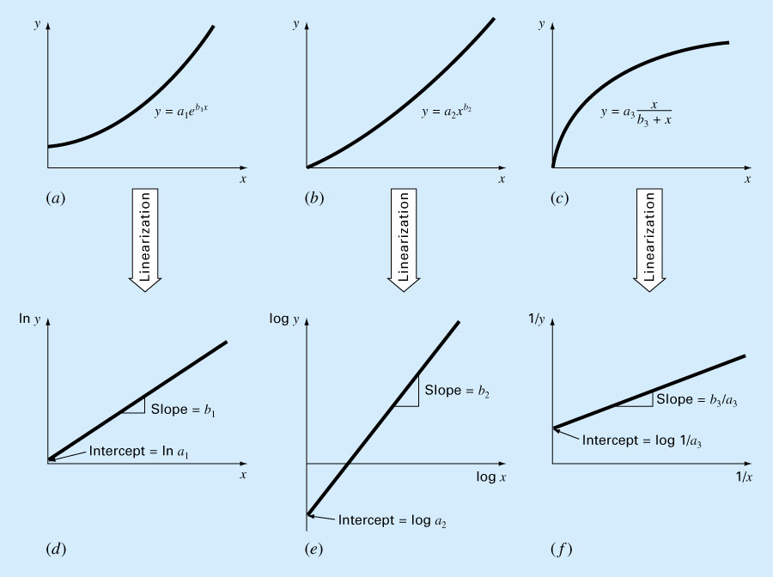
Linearization of Nonlinear Relationships 1. The exponential equation.
y* = a_{o} + a₁ x

Slide 27
Linearization of Nonlinear Relationships 2. The power equation
y* = a_{o} + a₁ x*

Slide 28
Linearization of Nonlinear Relationships 3. The saturation-growth-rate equation
y* = 1/y
a_{o} = 1/a₃
a₁ = b₃/a₃
x* = 1/x

Slide 29
Example
Fit the following Equation:
to the data in the following table:
x_{i} y_{i}
1 0.5
2 1.7
3 3.4
4 5.7
8.4
15 19.7
X*=log x_{i} Y*=logy_{i}
0 -0.301
0.301 0.226
0.477 0.534
0.602 0.753
0.699 0.922
2.079 2.141

Slide 30
Example
 | Xi | Yi | X*_{i}=Log(X) | Y*_{i}=Log(Y) | X*Y* | X*^2
 | 1 | 0.5 | 0.0000 | -0.3010 | 0.0000 | 0.0000
 | 2 | 1.7 | 0.3010 | 0.2304 | 0.0694 | 0.0906
 | 3 | 3.4 | 0.4771 | 0.5315 | 0.2536 | 0.2276
 | 4 | 5.7 | 0.6021 | 0.7559 | 0.4551 | 0.3625
 | 5 | 8.4 | 0.6990 | 0.9243 | 0.6460 | 0.4886
Sum | 15 | 19.700 | 2.079 | 2.141 | 1.424 | 1.169

Slide 31
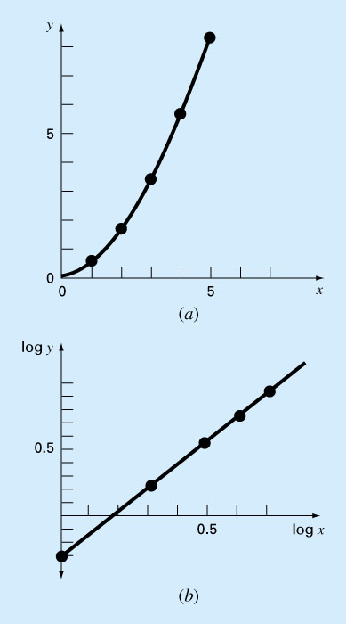
Linearization of Nonlinear Functions: Example
log y=-0.334+1.75log x

Slide 32
function [a, r2] = linregr(x,y)
% linregr: Regresion Lineal usando Minimos Cuadrados
% input:
% x = Variable Independent
% y = Variable Dependientedependent
% output:
% a = vector: a(1)= Pendiente, a(2)=Intercepto con el eje x
% r2 = coefficient of determination
n = length(x);
if length(y)~= n, error('x and y must be same length’); end
x = x(:); y = y(:); % convert to column vectors
sx = sum(x); sy = sum(y);
sx2 = sum(x.*x); sxy = sum(x.*y); sy2 = sum(y.*y);
a(1) = (n*sxy-sx*sy)/(n*sx2-sx^2);
a(2) = sy/n-a(1)*sx/n;
r2 = ((n*sxy-sx*sy)/sqrt(n*sx2-sx^2)/sqrt(n*sy2-sy^2))^2;
% create grafico de la data and best fit line
xp = linspace(min(x),max(x),2);
yp = a(1)*xp + a(2);
plot(x,y,'o',xp,yp)
grid on
end
Matlab Función, determia the Best linear Fit

Slide 33
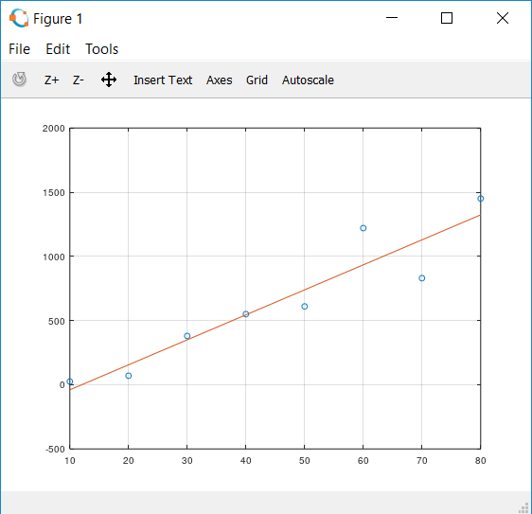
Example:
Use M-file to fit the data following:
>> x = [10 20 30 40 50 60 70 80];
>> y = [25 70 380 550 610 1220 830 1450];
>> [a, r2] = linregr (x,y)
a =
19.470 -234.286
r2 = 0.88049

